Slide 1
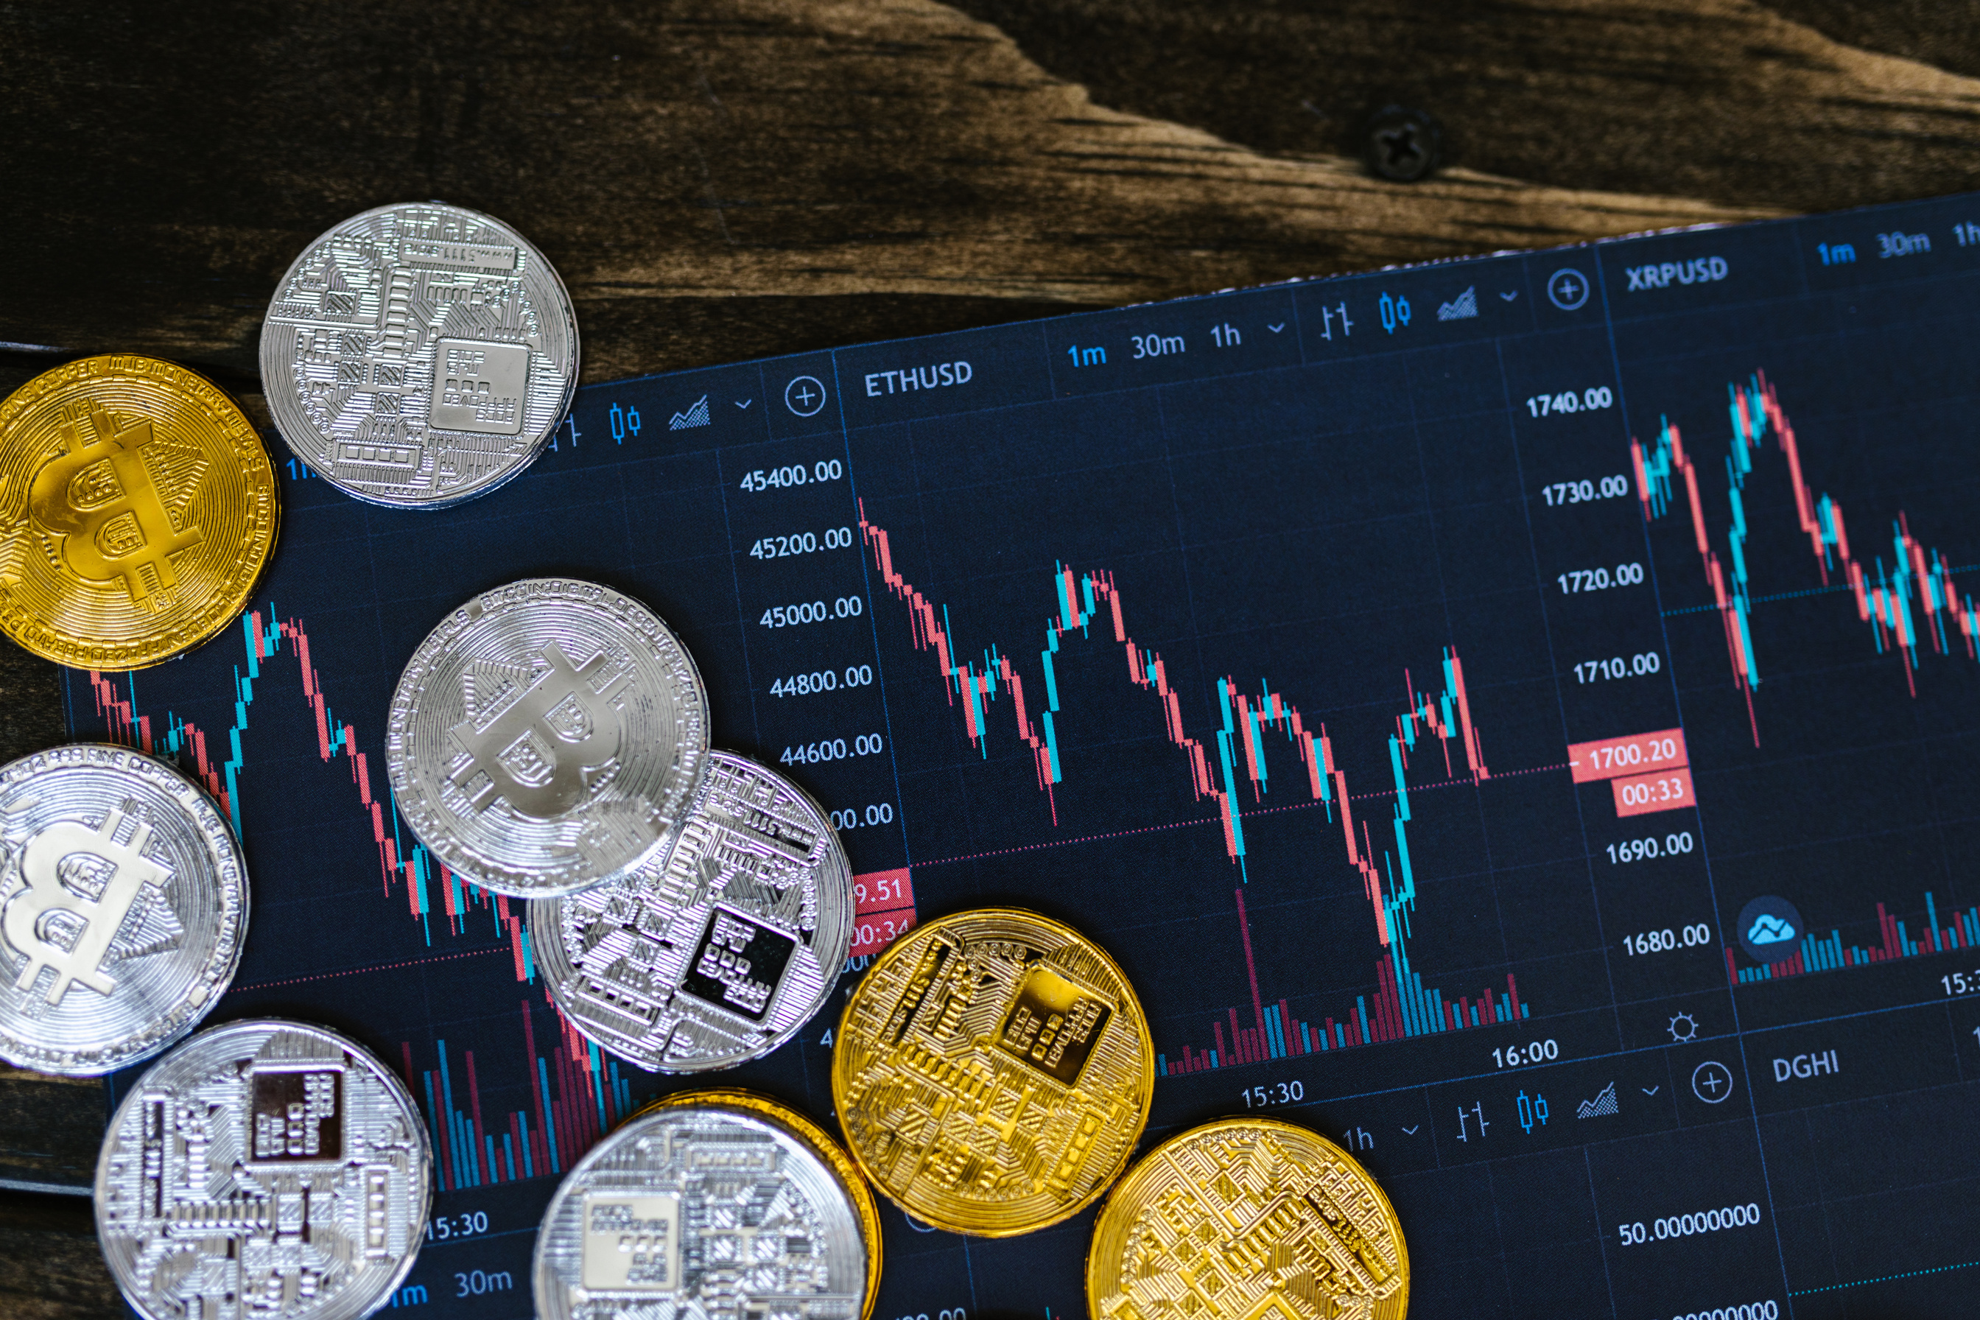


Larana, Inc.
CRYPTO-CURRENCY
Cryptocurrency Template Presentation
A presentation is a formal talk, often delivered in front of an audience, aimed at conveying information, persuading others, or sharing insights on a particular topic. Presentations can take various forms, such as verbal speeches, slideshows, demonstrations, or multimedia displays. They are commonly used in academic, professional, and social settings to communicate ideas, proposals, reports, or findings.
WWW.REALLYGREATSITE.COM

Slide 2


Larana, Inc.
ABOUT
COMPANY
A presentation is a formal talk, often delivered in front of an audience, aimed at conveying information, persuading others, or sharing insights on a particular topic. Presentations can take various forms, such as verbal speeches, slideshows, demonstrations, or multimedia displays. They are commonly used in academic, professional, and social settings to communicate ideas, proposals, reports, or findings. Effective presentations typically involve careful planning, organization, and delivery techniques to engage the audience and effectively convey the intended message.

Slide 3


Larana, Inc.
WHAT IS
CRYPTOCURRENCY?
A presentation is a formal talk, often delivered in front of an audience, aimed at conveying information, persuading others, or sharing insights on a particular topic. Presentations can take various forms, such as verbal speeches, slideshows, demonstrations, or multimedia displays. They are commonly used in academic, professional, and social settings to communicate ideas, proposals, reports, or findings. Effective presentations typically involve careful planning, organization, and delivery techniques to engage the audience and effectively convey the intended message.

Slide 4
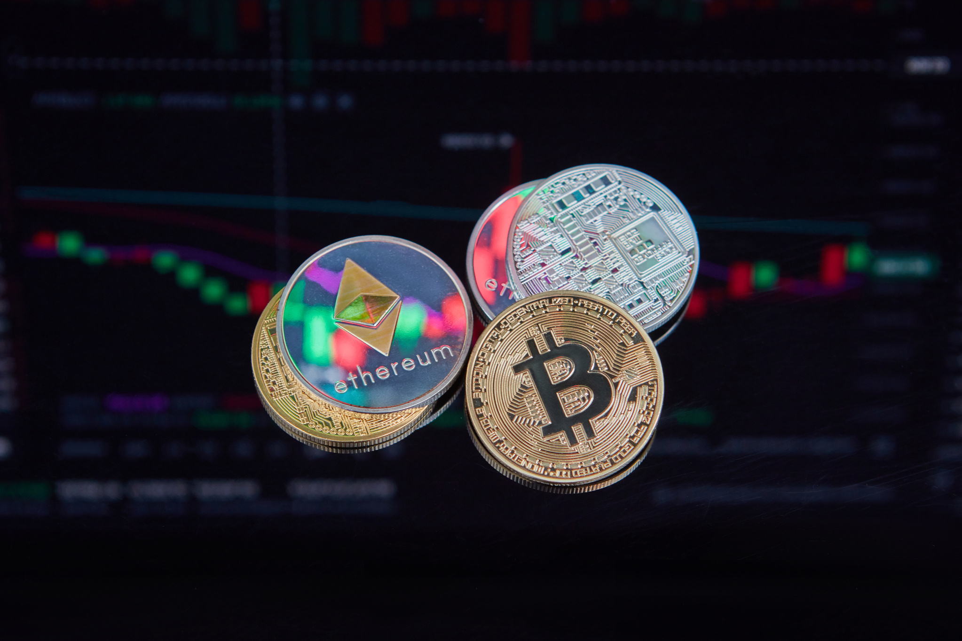
Larana, Inc.
HISTORY AND
EVOLUTION
A presentation is a formal talk, often delivered in front of an audience, aimed at conveying information, persuading others, or sharing insights on a particular topic. Presentations can take various forms, such as verbal speeches, slideshows, demonstrations, or multimedia displays. They are commonly used in academic, professional, and social settings to communicate ideas, proposals, reports, or findings. Effective presentations typically involve careful planning, organization, and delivery techniques to engage the audience and effectively convey the intended message.

Slide 5

Larana, Inc.
DECENTRALIZATION
AND BLOCKCHAIN
A presentation is a formal talk, often delivered in front of an audience, aimed at conveying information, persuading others, or sharing insights on a particular topic. Presentations can take various forms, such as verbal speeches, slideshows, demonstrations, or multimedia displays. They are commonly used in academic, professional, and social settings to communicate ideas, proposals, reports, or findings. Effective presentations typically involve careful planning, organization, and delivery techniques to engage the audience and effectively convey the intended message.

Slide 6






Larana, Inc.
BENEFIT OF
CRYPTOCURRENCY
Benefit 01
Benefit 02
A presentation is a formal talk, often delivered in front of an audience, aimed at conveying information, persuading others, or sharing insights on a particular topic. Presentations can take various forms, such as verbal speeches, slideshows, demonstrations, or multimedia displays. They are commonly used in academic, professional, and social settings to communicate ideas, proposals, reports, or findings. Effective presentations typically involve careful planning, organization, and delivery techniques to engage the audience and effectively convey the intended message.
Benefit 03
Benefit 04

Slide 7

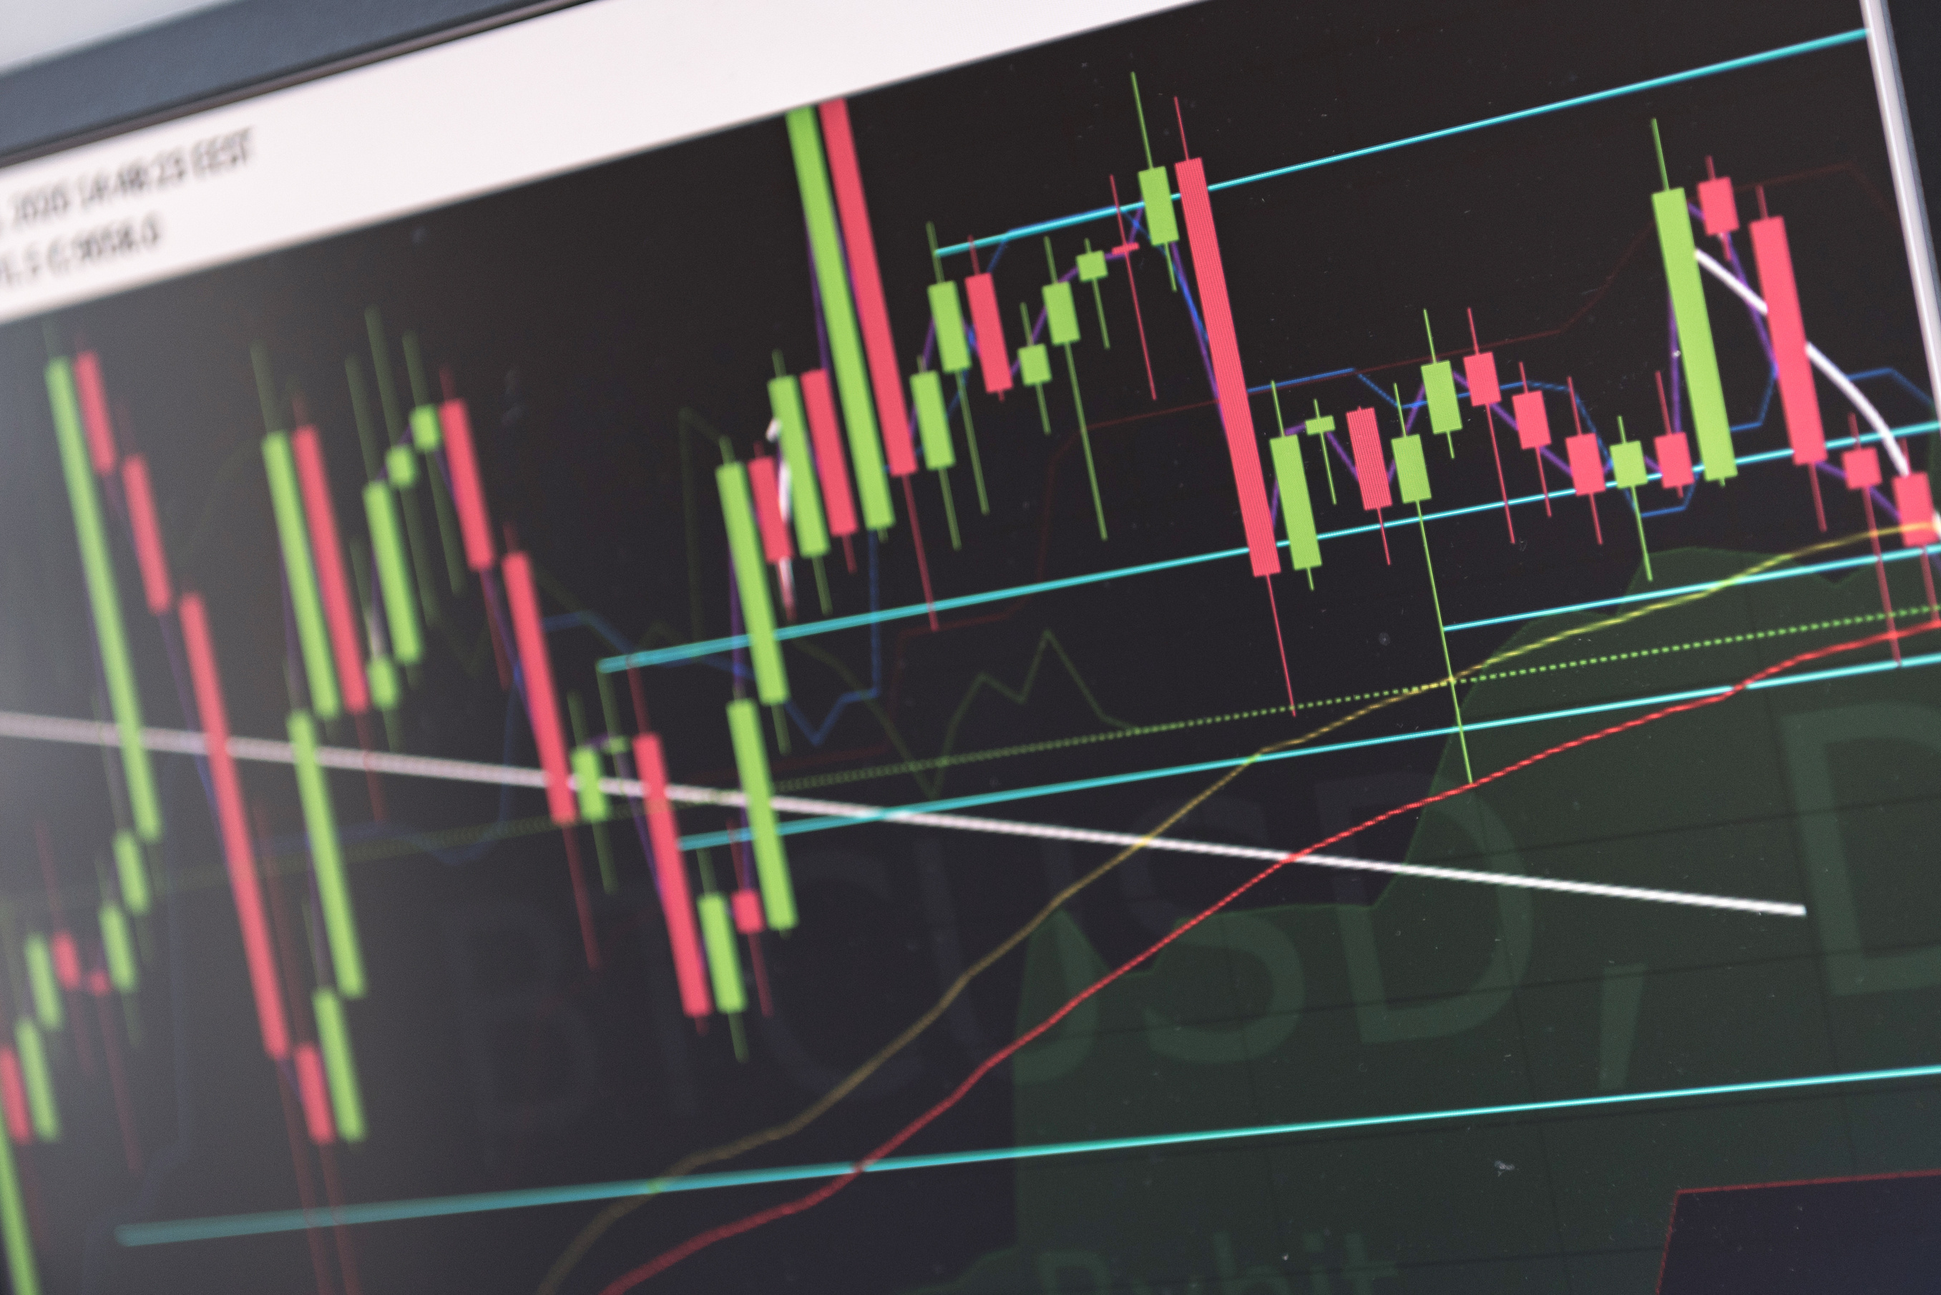
Larana, Inc.
CHALLENGES
AND RISK
A presentation is a formal talk, often delivered in front of an audience, aimed at conveying information, persuading others, or sharing insights on a particular topic. Presentations can take various forms, such as verbal speeches, slideshows, demonstrations, or multimedia displays. They are commonly used in academic, professional, and social settings to communicate ideas, proposals, reports, or findings. Effective presentations typically involve careful planning, organization, and delivery techniques to engage the audience and effectively convey the intended message.

Slide 8

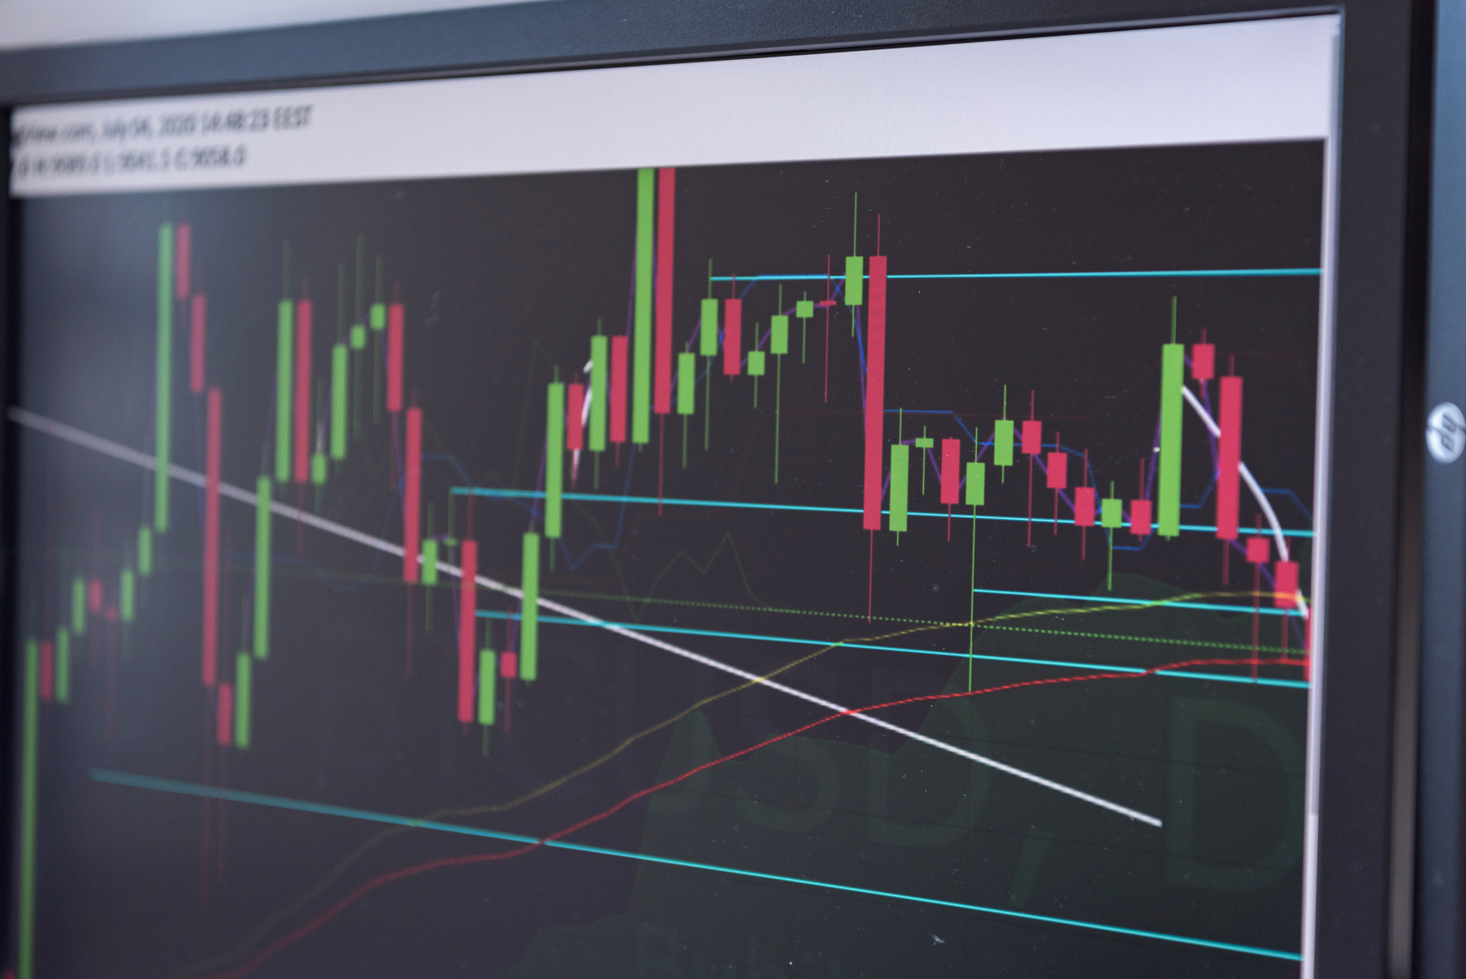

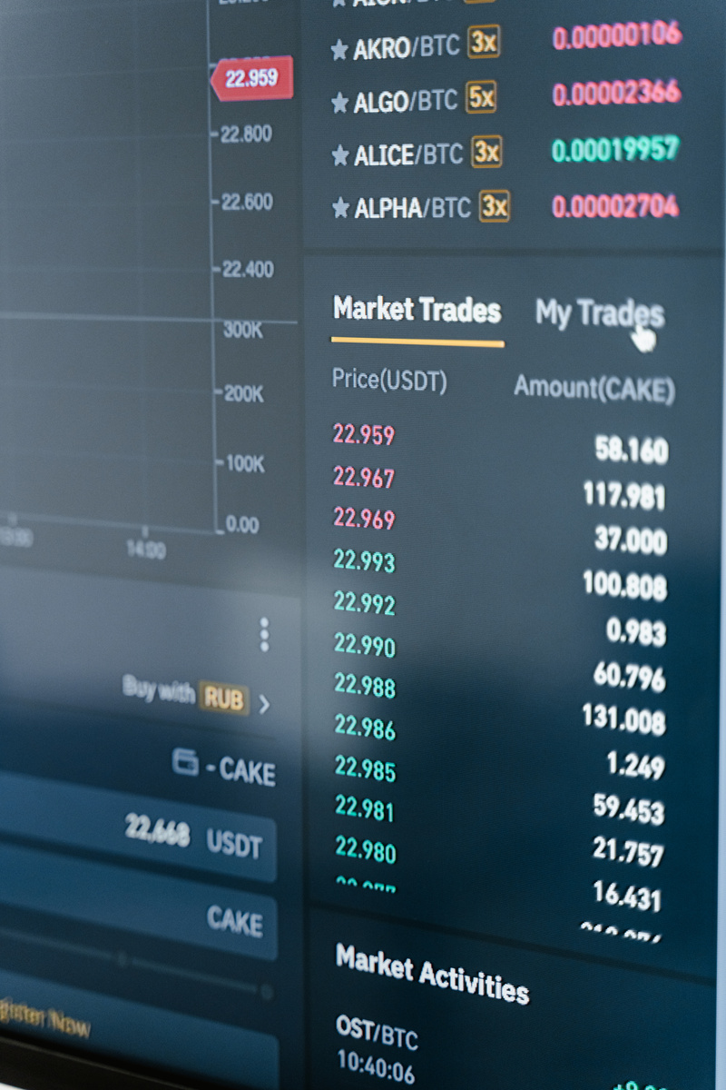

Larana, Inc.
LEADING
AND MARKET
A presentation is a formal talk, often delivered in front of an audience, aimed at conveying information, persuading others, or sharing insights on a particular topic. Presentations can take various forms, such as verbal speeches, slideshows, demonstrations, or multimedia displays. They are commonly used in academic, professional, and social settings to communicate ideas, proposals, reports, or findings. Effective presentations typically involve careful planning, organization, and delivery techniques to engage the audience and effectively convey the intended message.

Slide 9


Larana, Inc.
REAL-WORLD
APPLICATION
A presentation is a formal talk, often delivered in front of an audience, aimed at conveying information, persuading others, or sharing insights on a particular topic. Presentations can take various forms, such as verbal speeches, slideshows, demonstrations, or multimedia displays. They are commonly used in academic, professional, and social settings to communicate ideas, proposals, reports, or findings. Effective presentations typically involve careful planning, organization, and delivery techniques to engage the audience and effectively convey the intended message.

Slide 10


Larana, Inc.
INVESTMENT
AND TRADING
A presentation is a formal talk, often delivered in front of an audience, aimed at conveying information, persuading others, or sharing insights on a particular topic. Presentations can take various forms, such as verbal speeches, slideshows, demonstrations, or multimedia displays. They are commonly used in academic, professional, and social settings to communicate ideas, proposals, reports, or findings. Effective presentations typically involve careful planning, organization, and delivery techniques to engage the audience and effectively convey the intended message.

Slide 11





Larana, Inc.
THANK YOU
www.reallygreatsite.com
hello@reallygreatsite.com
+123-456-7890

